Slide 1
Machine Learning CSE 445 Summer 2022

Slide 2
CSE 445 Lecture 2
Thinking about DATA
Sarnali Basak
Associate Professor,
Dept. of Computer Science and Engineering,
Jahangirnagar University

Slide 3

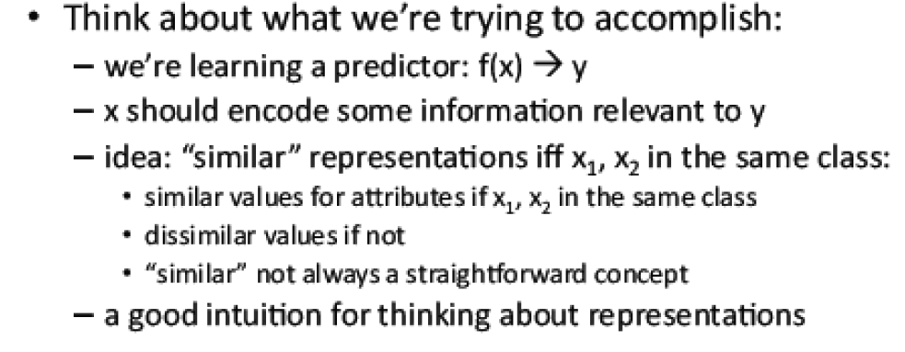
Picking Attributes

Slide 4

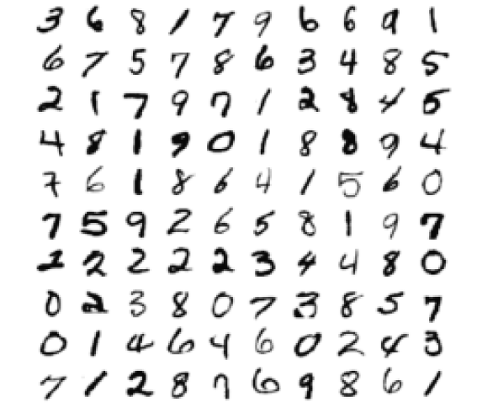
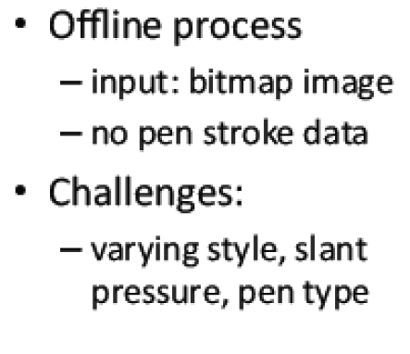
Example 1: Digit Recognition

Slide 5
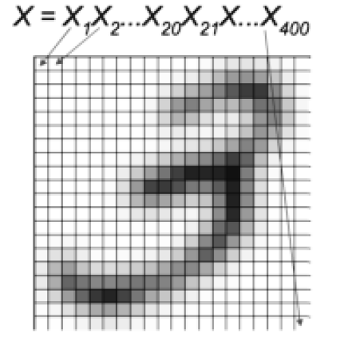
Example 2: Handwritten digit

Slide 6
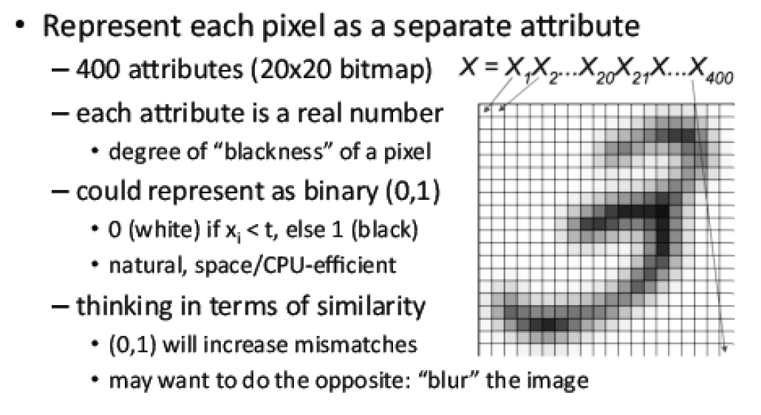
Handwritten Digit: Attributes

Slide 7
Why blurring helps Machine Learning?

Slide 8



Images pixels as attributes

Slide 9
When pixels work as attributes and when they don’t?

Slide 10
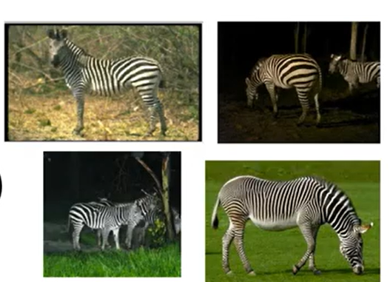
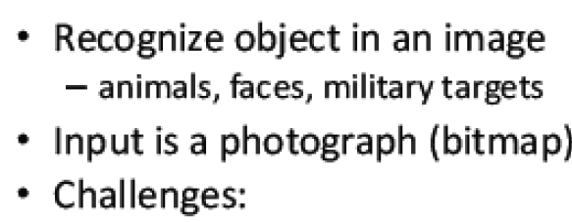

Attributes for object recognition
Example 3: Object Recognition

Slide 11
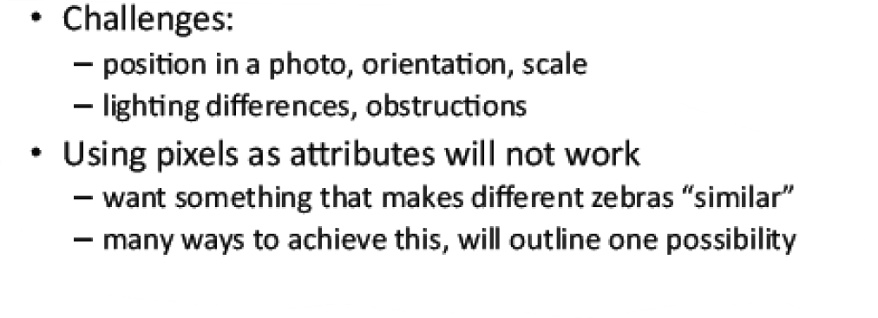
Example 3: Object Recognition

Slide 12
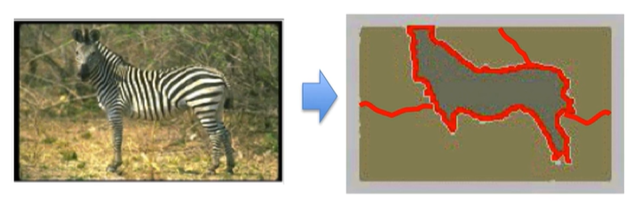
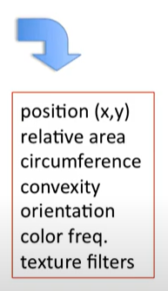
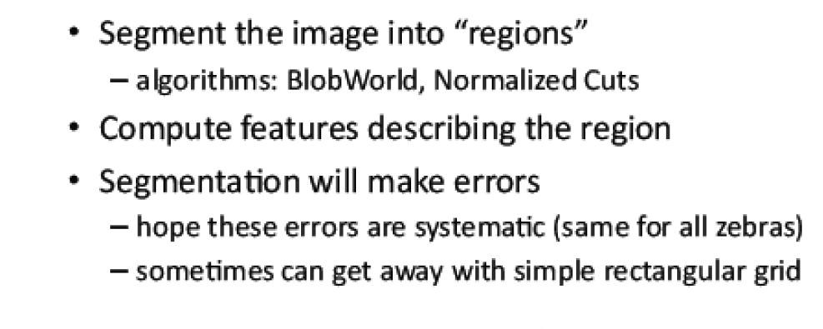
Object recognition: Attributes

Slide 13
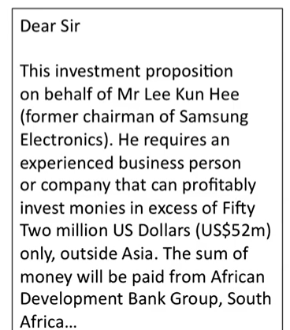
Example 4: Text Classification

Slide 14
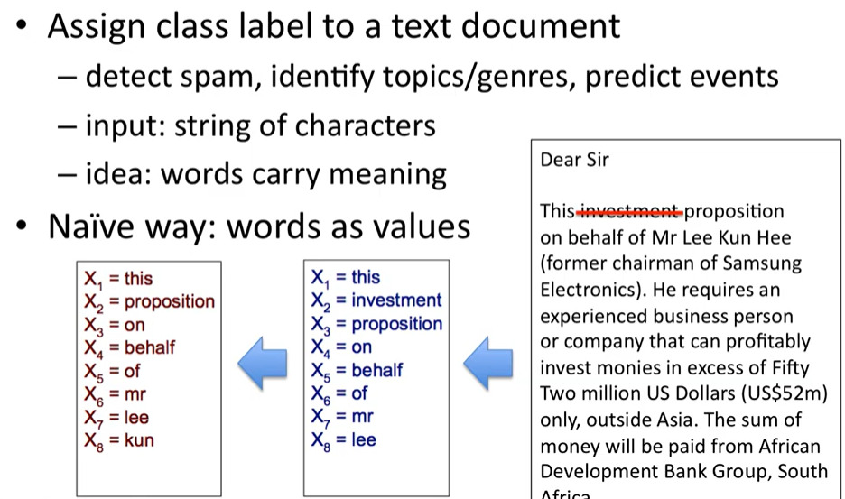
Example 4: Text Classification

Slide 15
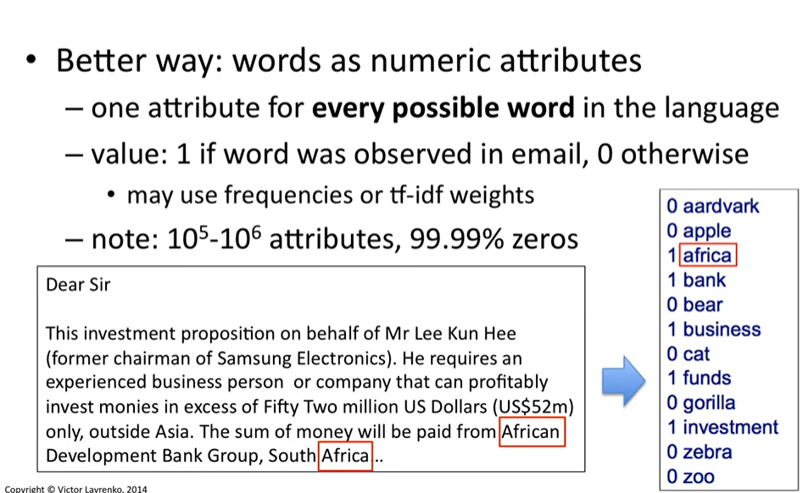
Example 4: Text Classification

Slide 16
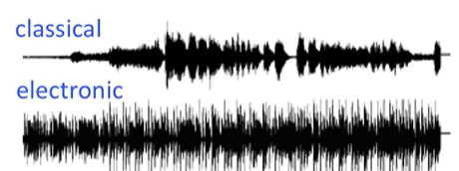
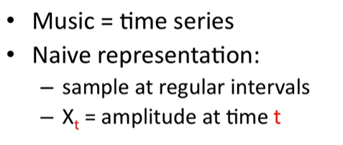
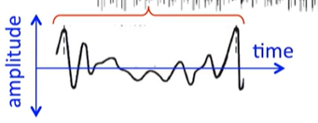
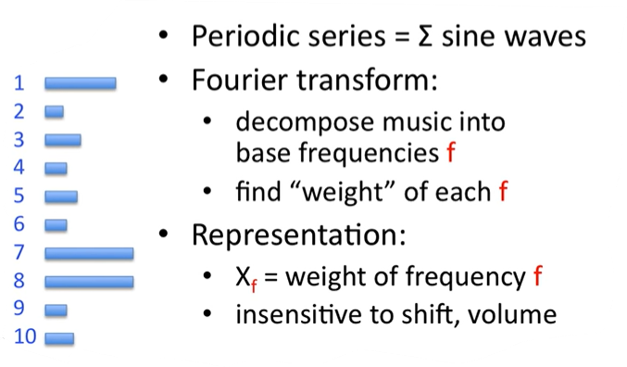
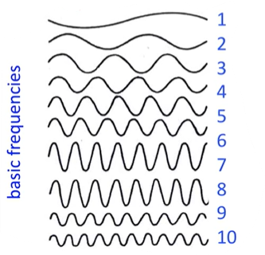
Example 5: Music Classification

Slide 17



Supervised vs Unsupervised Learning

Slide 18

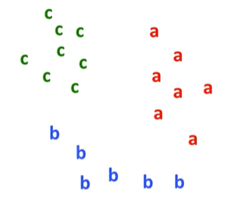
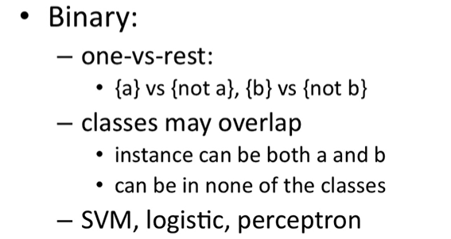
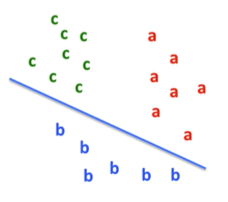
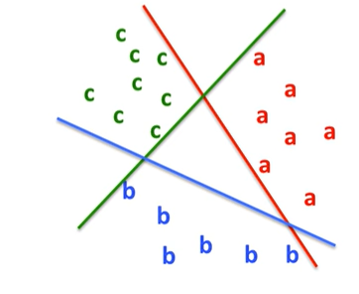
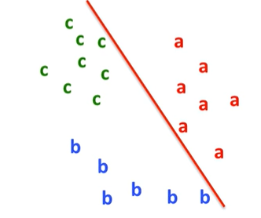
Multi Class vs Binary Class

Slide 19
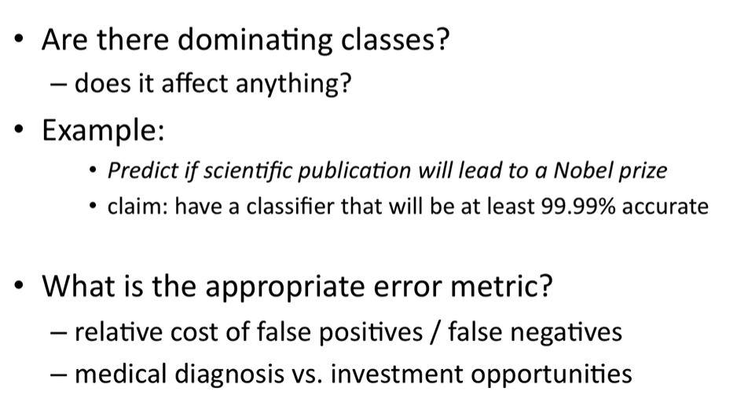
What are we predicting?

Slide 20
Important to notice!
Classification accuracy and Imbalanced Classes

Slide 21
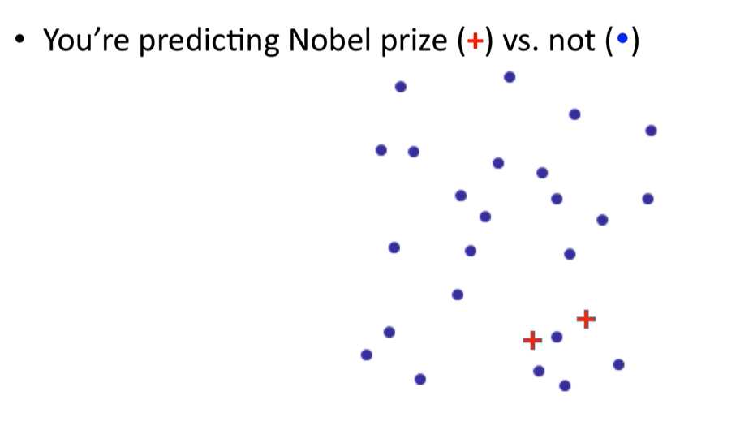
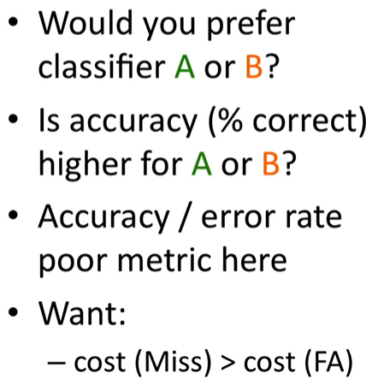
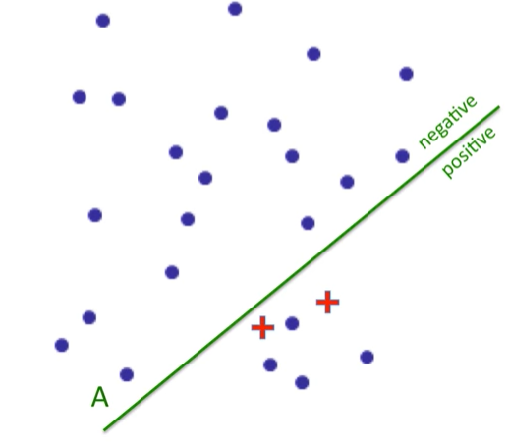
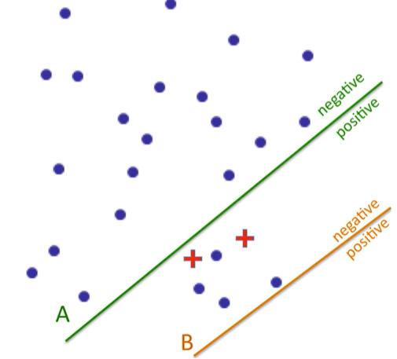
Accuracy vs Un-balanced Classes

Slide 22
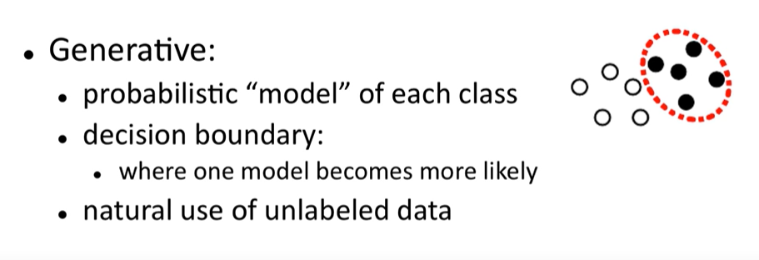

Generative vs Discriminative

Slide 23


Question? How to represent structured objects in machine learning?

Slide 24
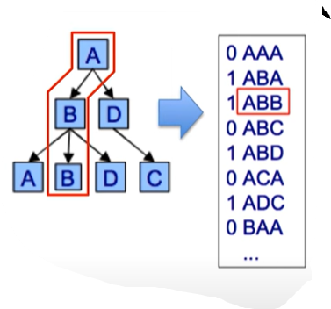

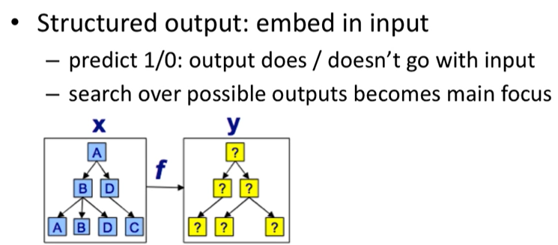
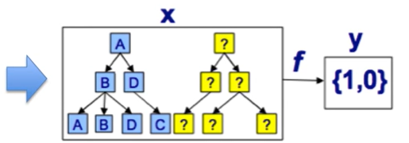
Dealing with Structure

Slide 25
Detect outliers by visualizing its data

Slide 26
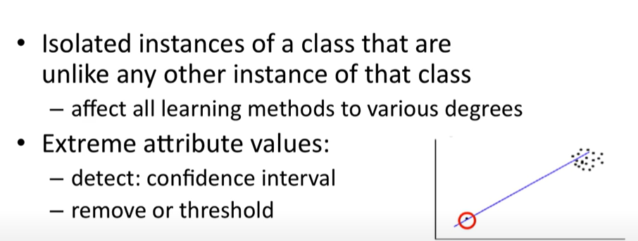

Outliers in the data

Slide 27
Dealing with Missing Data

Slide 28



Missing Data

